Slide 1

EdgeConnect+: Adversarial Inpainting with Edge and Color Guidance Final Project Presentation
Spring 2025, CSE 6367 – Computer Vision
Abhinay Kotla, Sanjana Ravi Prakash
May 6th, 2025
Notes:
Good afternoon, everyone! We are Sanjana Ravi Prakash and Abhinay Kotla from Team 2, and today we’re excited to present our final project — EdgeConnect+: Adversarial Inpainting with Edge and Color Guidance. If you’ve ever seen an image with something awkward photoshopped out… and it looked off, that’s the kind of problem we’re trying to solve but with a smarter approach.

Slide 2
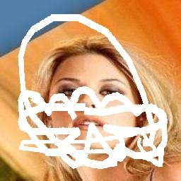

Introduction
What is Image Inpainting?
Filling missing or corrupted regions in images.
Applications: object removal, photo restoration, creative editing
Challenge: Traditional & deep learning methods struggle with realism, structure, and color consistency
Our Goal: Improve perceptual realism using edge + color guidance
Notes:
Let’s start with the basics: what is image inpainting? image inpainting is the task of filling in missing or damaged parts of an image. It's used in things like photo restoration, removing unwanted objects, or creative edits. The tricky part is making it look natural, matching the edges, colors, and textures so it doesn’t look fake. That’s exactly what we set out to improve.

Slide 3
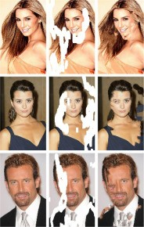
Related Work
Traditional Methods:
Diffusion (Bertalmio et al.), Exemplar-based (Criminisi et al.). [3]
Struggle with large/masked regions
Deep Learning Approaches:
Context Encoders, Partial & Gated Convolutions. [4,6]
Attention (DeepFill), HiFill, CoModGAN
Structure-based: PEN-Net, RFR, EdgeConnect
Color-aware: FusionLabel (uses edge + color fusion)
Limitation: Lack of integrated color guidance
Notes:
There’s been a lot of progress in inpainting over the years. Early methods used techniques like diffusion and patch copying. They were okay for small or texture-heavy areas, but they struggled when the missing region was large or complex. Then came deep learning — models like Context Encoders, Partial &Gated Convolutions brought real improvements. Attention based mechanisms like DeepFill, HiFill, CoModGAN were also introduced. Some get the structure right. Others try to make it look artsy. Then came structure-first approaches like PEN-Net and EdgeConnect, which used edges to guide the fill — a smart move, but they ignored color. More recently, LaMa took on large masks using Fourier convolutions and perceptual loss — it looked great, but lacked control and flexibility. On the other hand, some methods like FusionLabel tried to bring in color but were often heavy or hard to adapt. Our idea: combine the strengths of both in a cleaner, more modular design

Slide 4
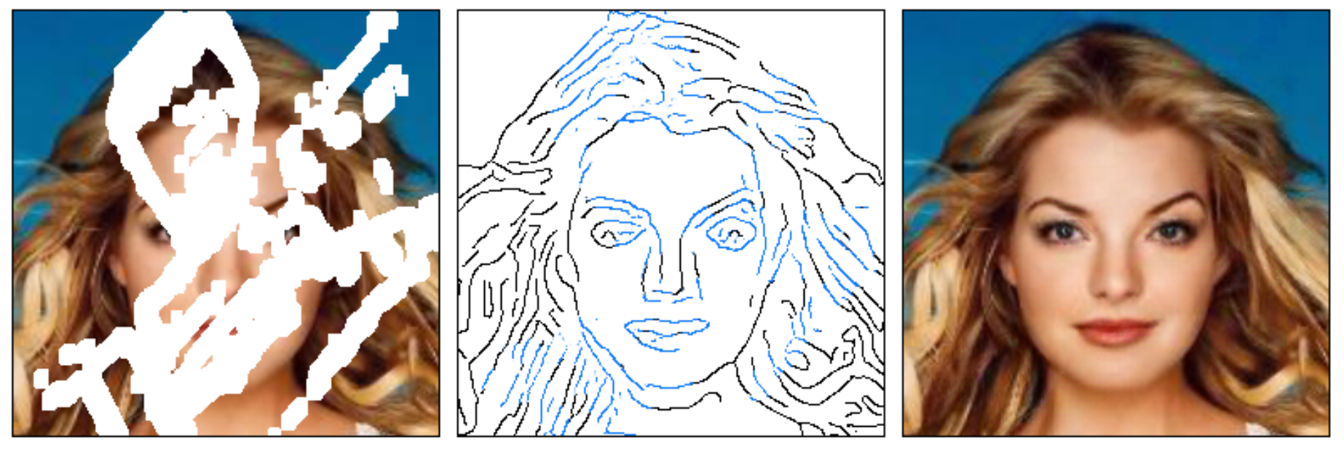
EdgeConnect Overview
EdgeConnect Overview:
Two-stage framework: G1 for edge generation, G2 for image completion
Focuses solely on structural guidance using Canny edges and grayscale input
Issues with EdgeConnect:
No explicit color modeling → leads to unnatural transitions or color mismatches
Relies on manually provided masks → reduces automation
Limited perceptual alignment in complex textures and facial regions
Motivation: Address these gaps through integrated edge + color + mask input in a modular pipeline
[1] Nazeri et al.
Notes:
EdgeConnect was a great starting point — it introduced a two-stage pipeline where the first stage predicts edges and the second stage uses those edges to fill in the missing parts of an image. It brought a major improvement in terms of structure, using edge maps to guide image completion. But it had a few limitations. First, Color was a missing piece. Without modeling chromatic information, the outputs had some inconsistencies, like color bleeding or washed-out regions, especially in faces and detailed textures . Second, it required manually provided binary masks, which made it less practical for real-world use. And third, it struggles with fine details in areas like facial features. So with EdgeConnect+, we aimed to fix all of that: we automated the mask extraction, introduced a color guidance stage using low-frequency color priors, and restructured the entire pipeline into a clean, modular design. It’s still edge-first — but now with color-aware completion that looks far more natural and coherent. Abhinay will now explain about our methodology

Slide 5
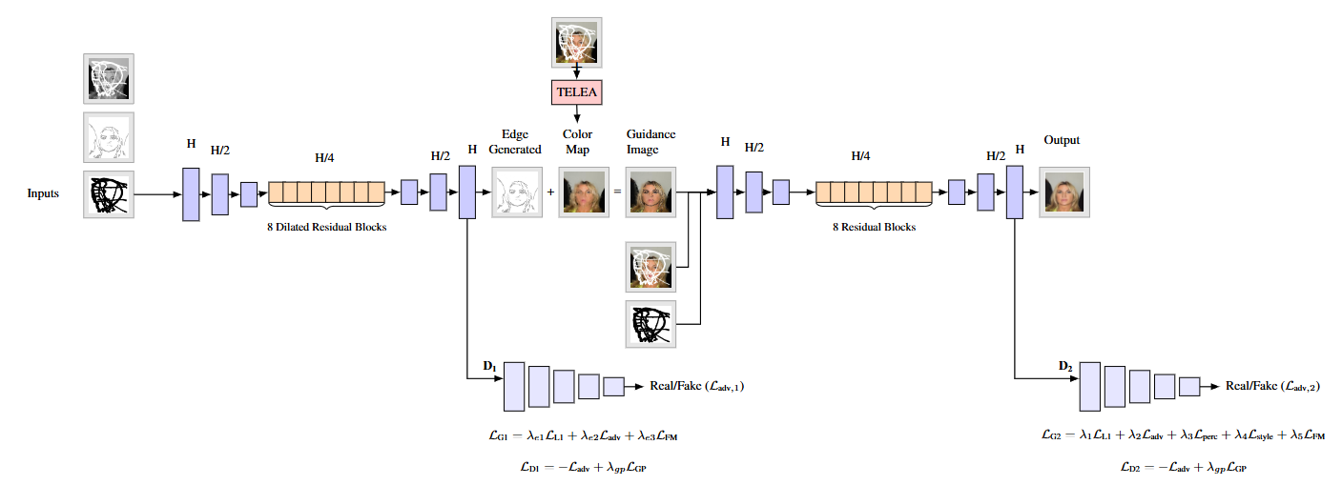
EdgeConnect+
Three-Stage Framework:
Edge Generation (G1)
Color Fusion Guidance
Image Completion (G2)
Key Insight: Combine structural and chromatic cues in a modular design
Benefits:
Enhanced realism
Better semantic alignment
Notes:
So this is where our model, EdgeConnect+, comes in.
It’s a three-stage pipeline: we first generate edges, then fuse those with a color map, and finally use that guidance to complete the image.
The key idea here is we don’t just rely on structure. We also bring in color to guide the inpainting, which helps with more natural, realistic results.
This diagram shows the full flow, but we’ll go step-by-step through each part next.

Slide 6
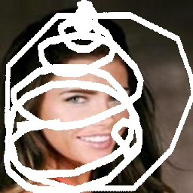
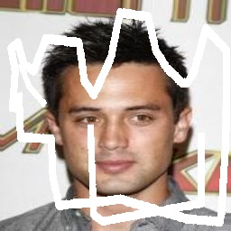
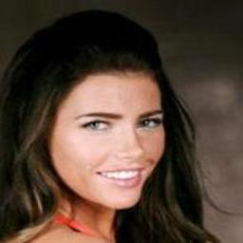
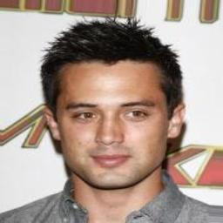
Dataset
CelebA (200K+ face images)
Train: 162k, Val: 10k, Test: 30k
Image size : Resized to 256 X 256
Masks: ≥ 20% random irregular regions
[2] Liu et al
Notes:
We used the CelebA dataset with over 200k face images. All the images are resized to 256x256 to keep a uniform input size.
As you can see here, we applied random irregular hand drawn masks covering at least 20% of the image to simulate real-world missing regions.

Slide 7
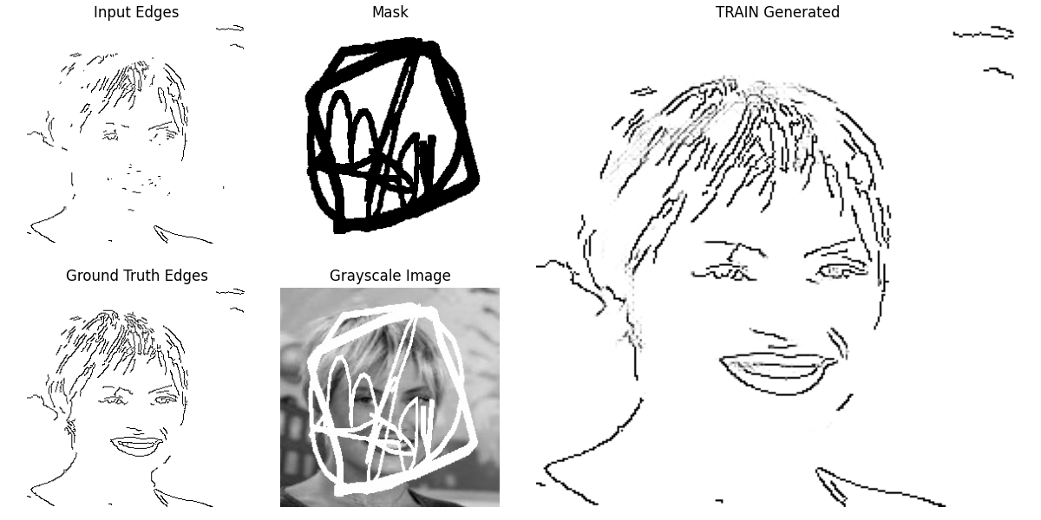
Step 1 : G1 - Edge Generator
Input: Grayscale image + Canny edges + binary mask
Architecture: Encoder-decoder with dilated residual blocks
Losses:
L1 Loss (pixel-wise)
Adversarial Loss (PatchGAN)
Feature Matching Loss
Goal: Predict semantically consistent edges
[3,12]
Notes:
This is the first stage of our model, where we generate edges for the masked image.
Let’s walk through what you see here. In the bottom middle, we have the grayscale image with missing regions, and on the top right, the black binary mask. These, along with the Canny edge map, form the input to our G1 network.
G1 follows an encoder-decoder architecture with dilated residual blocks, which helps it capture both fine and contextual features around the missing areas.
It’s trained using three types of losses:
L1 loss for pixel-wise accuracy,
Adversarial loss using a PatchGAN discriminator to make edge predictions look real,
And feature matching loss, which encourages consistency in the intermediate layers.
The goal is to produce semantically meaningful edges, like the result on the far right, even when much of the structure is missing in the input.

Slide 8
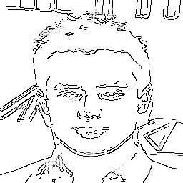
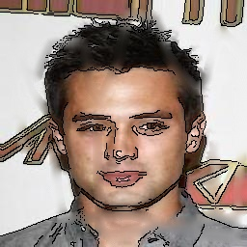
Step 2 : Color Guidance
Why needed?
Structure-only → color mismatch or desaturation
Steps:
TELEA inpainting for low-frequency color prior
Overlay predicted edges as black strokes
Result: Color + Structure composite image
Notes:
Now that we’ve predicted the edges, we bring in color guidance, which is a key addition in our model.
Why do we need this? If we use only structure, we often get weird color mismatches or desaturated results, especially around facial features or textured regions.
So here’s what we do:
First, we apply TELEA inpainting to the masked image, it gives us a smooth, blurry color estimate for the missing region.
Then, we overlay the predicted edges, you can see that in the top image, where the edges are shown as black strokes on top of the TELEA result.
The result is this fused image below, which combines both low-frequency color and high-frequency structure.
This fusion acts as the main guidance input to our next stage, G2.

Slide 9
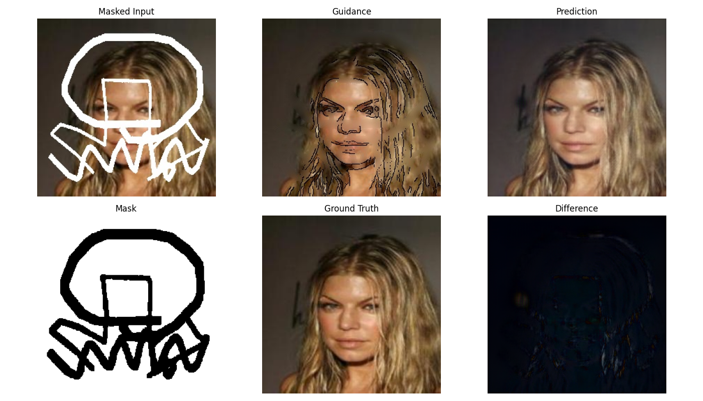
Step 3 : G2 - Final Image Completion
Input:
Masked RGB + Fused Guidance + Mask = 7 channels
Architecture: Residual blocks, no skip connections
Losses:
L1 (masked region)
Perceptual & Style (VGG)
Adversarial (D2)
Feature Matching
Goal: Generate realistic and aligned output
Notes:
The final step is G2, where we generate the completed image using everything we’ve built so far.
The input to G2 includes 7 channels, the masked RGB image, the guidance image from the previous step, and the mask.
G2 uses a stack of residual blocks, without any skip connections, to keep the architecture clean and generalizable.
On the right, you can see the whole flow:
The masked input,
The guidance image combining edges and color,
Our final prediction,
And below that, the ground truth and difference map, showing how close we get.
We train G2 using a combination of losses, L1 for pixel accuracy, VGG-based perceptual and style losses, adversarial loss with D2, and feature matching.
The result is a more realistic and semantically aligned output, even in complex facial regions.

Slide 10
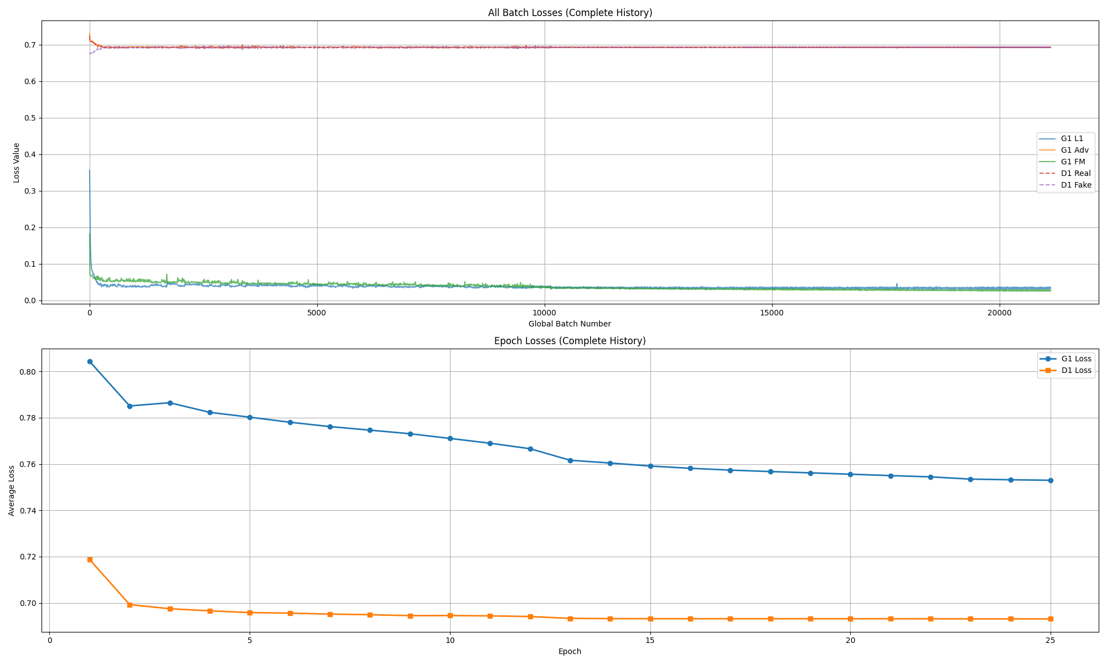
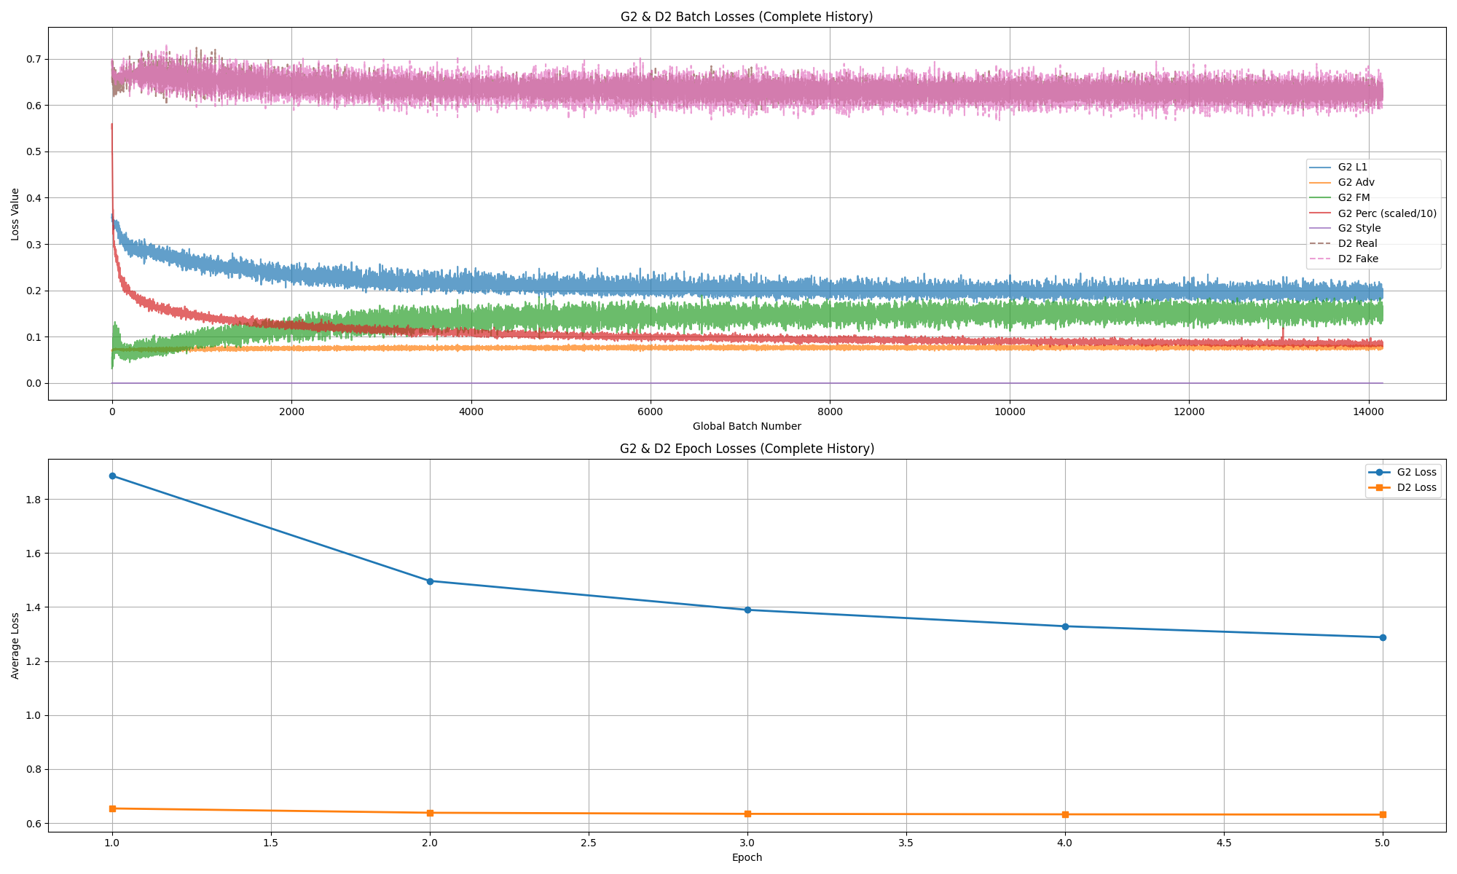
Training
Interruptible and Resumable
G1: 25 epochs
G2: 5 epochs (early results)
16 bit Mixed precision, EMA, early stopping
Trained on Nvidia A100
Notes:
Our model was trained in two stages. We trained G1, the edge generator, for 25 epochs, and G2. the final image completion network, for just 5 epochs, since we were limited by compute time.
We used mixed precision to speed things up and reduce memory usage, along with EMA for smoothing, and early stopping to avoid overfitting.
All of this was done on an NVIDIA A100 GPU.
On the right, you can see the training curves. The top graphs show G1 and D1 losses over batches and epochs, and below that are G2 and D2 training losses. You’ll notice that despite fewer epochs, G2’s loss steadily drops, showing that even early training gives promising results.

Slide 11
Quantitative Results
Metric | Fusion Label | EdgeConnect | Ours
PSNR | 29.16 | 25.28 | 25.23
SSIM | 0.9235 | 0.846 | 0.864
L1 Loss (%) | Not reported | 3.03 | 4.83
FID | Not reported | 2.82 | 2.64
LPIPS | Not reported | Not reported | 0.193
Observations:
PSNR: Slightly lower than EdgeConnect due to prioritizing perceptual over pixel-level accuracy
SSIM: Higher than EdgeConnect, indicating better preservation of structure and luminance
L1 Loss: Marginally higher, consistent with a focus on perceptual rather than strict pixel match
FID: Slightly lower, suggesting outputs are more realistic and closer to real image distributions
LPIPS: Demonstrates improved perceptual quality; not reported for other methods
Overall, our approach offers a perceptual and structural advantage over structure-only methods
Notes:
Now lets look at some numbers. We evaluated our model on these metrics:
PSNR Peak Signal-to-Noise Ratio evaluates reconstruction fidelity by comparing pixel-level differences. Its close to EdgeConnect’s, but slightly lower — which is fine because we’re optimizing for realism, not just pixel accuracy.
SSIM Structural Similarity Index (SSIM) measures perceptual quality in terms of luminance, contrast, and structure. It’s higher, showing better structure and tone preservation.
L1 Loss — also known as mean absolute error — gives us a sense of how far off we are, pixel by pixel. Ours is slightly higher than EdgeConnect, which makes sense because we focus less on exact pixel matches and more on realistic appearance.
Fr´echet Inception Distance (FID) evaluates image realism and diversity. EdgeConnect+ achieves a FID score of 2.64, indicating reasonably good alignment with natural image distributions
LPIPS (Learned Perceptual Image Patch Similarity), which compares images based on deep features — shows solid perceptual quality.

Slide 12
Conclusions
Summary:
EdgeConnect+ = Structure + Color → Better realism
Modular and interpretable
Promising results with limited training
Limitations:
G2 was trained for only 5 epochs due to limited computational resources
Performance might improve significantly with longer training and more hardware support
Notes:
To wrap up — EdgeConnect+ blends structure and color to bring back missing image parts in a way that looks more natural and realistic. It’s modular, so each part can be tweaked or improved easily. And even with limited training, it showed real promise — we think there’s a lot more potential with extended training and modifications.

Slide 13
Future Work
Longer training, semantic guidance, attention fusion
Extend to Places2 [26], and non-face datasets
Add additional inputs like depth to enhance structural accuracy
inspired by recent work on diffusion and structure-aware inpainting [15, 23]
Notes:
To improve our results further, we plan to train G2 longer, right now it’s just 5 epochs, and explore semantic guidance and attention-based fusion to make the outputs even more context-aware.
We also want to move beyond CelebA by training on more diverse datasets like Places2, which includes scenes and backgrounds, not just faces.
Finally, we’d like to experiment with adding extra inputs like depth maps. This could help the model better understand 3D structure, especially in complex or occluded areas, a direction inspired by recent work on diffusion and structure-aware inpainting.

Slide 14
References
[1] K. Nazeri, E. Ng, T. Joseph, F. Qureshi, and M.Ebrahimi. EdgeConnect: Generative image inpaint-ing with adversarial edge learning. arXiv preprintarXiv:1901.00212, 2019.
[2] Z. Liu, P. Luo, X. Wang, and X. Tang. Deep learningface attributes in the wild. In International Conferenceon Computer Vision (ICCV), 2015.
[3] I. Goodfellow, J. Pouget-Abadie, M. Mirza, B. Xu,D. Warde-Farley, S. Ozair, A. Courville, and Y. Ben-gio. Generative adversarial networks. arXiv preprintarXiv:1406.2661, 2014.
[4] D. Pathak, P. Krahenbuhl, J. Donahue, T. Darrell, andA. A. Efros. Context encoders: Feature learning byinpainting. In CVPR, pages 2536–2544, 2016.
[5] S. Darabi, E. Shechtman, C. Barnes, D. B. Gold-man, and P. Sen. Image melding: Combining inconsis-tent images using patch-based synthesis. ACM TOG,31(4):82–1, 2012.
[6] G. Liu, F. A. Reda, K. J. Shih, T. C. Wang, A. Tao,and B. Catanzaro. Image inpainting for irregular holesusing partial convolutions. In ECCV, pages 85–100,2018.
[7] J. Yu, Z. Lin, J. Yang, X. Shen, X. Lu, and T. S. Huang.Free-form image inpainting with gated convolution. InICCV, pages 4471–4480, 2019.
[8] J. Yu, Z. Lin, J. Yang, X. Shen, X. Lu, and T. S. Huang.Generative image inpainting with contextual attention.In CVPR, pages 5505–5514, 2018.
[9] S. Zhao, Z. Liu, Z. Lin, J.-Y. Zhu, and W. Xu. Co-ModGAN: Co-modulated generative adversarial net-works. In NeurIPS, 34:4439–4452, 2021.
[10] J. Johnson, A. Alahi, and L. Fei-Fei. Perceptual lossesfor real-time style transfer and super-resolution. InECCV, pages 694–711. Springer, 2016.
[11] L. A. Gatys, A. S. Ecker, and M. Bethge. Image style transfer using convolutional neural networks. In CVPR, pages 2414–2423, 2016.
[12] I. Gulrajani, F. Ahmed, M. Arjovsky, V. Dumoulin, and A. Courville. Improved training of Wasserstein GANs. In NeurIPS, pages 5767–5777, 2017.
[13] R. Zhang, P. Isola, A. A. Efros, E. Shechtman, and O. Wang. The unreasonable effectiveness of deep features as a perceptual metric. In CVPR, pages 586–595, 2018.
[14] Z. Wang, A. C. Bovik, H. R. Sheikh, and E. P. Simoncelli. Image quality assessment: From error visibility to structural similarity. IEEE TIP, 13(4):600–612, 2004.
[15] B. Xia, Y. Zhang, S. Wang, Y. Wang, X. Wu, Y. Tian, W. Yang, and L. Van Gool. DiffIR: Efficient diffusion model for image restoration. arXiv preprint arXiv:2308.07950, 2023.
[16] M. Bertalmio, G. Sapiro, V. Caselles, and C. Ballester. Image inpainting. In Proc. SIGGRAPH, pages 417–424, 2000.
[17] A. Criminisi, P. Perez, and K. Toyama. Region filling and object removal by exemplar-based image inpainting. IEEE TIP, 13(9):1200–1212, 2004.
[18] L. Yi, Y. Liu, Y. Luo, Y. Xu, and J. Tang. Contextual residual aggregation for ultra high-resolution image inpainting. In CVPR, pages 7508–7517, 2020.
[19] Y. Liu, S. Wang, Y. Xu, J. Tang, and B. Li. Structureaware image inpainting with multi-scale gated convolutions. In CVPR, pages 2756–2765, 2022.
[20] Y. Zeng, J. Fu, H. Chao, and Y. Zheng. Learning pyramid-structure attention for image inpainting. In ECCV, pages 481–497, 2020.
[21] Y. Li, S. Liu, J. Yang, and M.-H. Yang. Recurrent feature reasoning for image inpainting. In CVPR, pages 7760–7768, 2020.
[22] R. Wan, Y. Zhang, Z. Li, Y. Wang, and L. Ma. Image inpainting via learning contextual residual aggregation. In CVPR, pages 8281–8290, 2021.
[23] A. Lugmayr, M. Danelljan, and R. Timofte. RePaint: Inpainting using denoising diffusion probabilistic models. arXiv preprint arXiv:2201.09865, 2022.
[24] H. Liu, X. Zhang, Y. Wan, and D. Lin. PD-GAN: Probabilistic diverse GAN for image inpainting. In CVPR, pages 9371–9381, 2021.
[25] H. Shao, Y. Wang, Y. Fu, and Z. Yin. Generative image inpainting via edge structure and color aware fusion. Journal of Visual Communication and Image Representation, 2021.
[26] https : / / www . kaggle . com / datasets / nickj26/places2-mit-dataset

Slide 15
Thank You

Slide 16
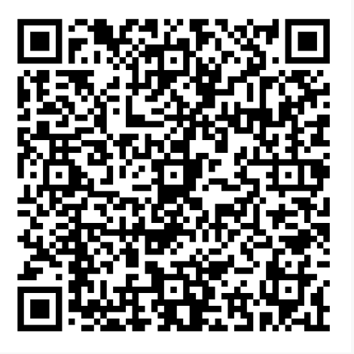
Abhinay Kotla axk5827@mavs.uta.edu Sanjana Ravi Prakash sxr8375@mavs.uta.edu
Q&A
https://github.com/Abhinaykotla/EdgeConnect_Plus_Inpainting_with_Edge_and_Color_Guidance

